Slide 1
Capstone Project – The Battle of Neighborhoods
| Finding a Better Place in Scarborough, Toronto

Slide 2
INTRODUCTION
The purpose of this Capstone Project is to help people in exploring better facilities around their neighborhood. It will help people making smart and efficient decision on selecting great neighborhood out of numbers of other neighborhoods in Scarborough, Toranto.

Slide 3
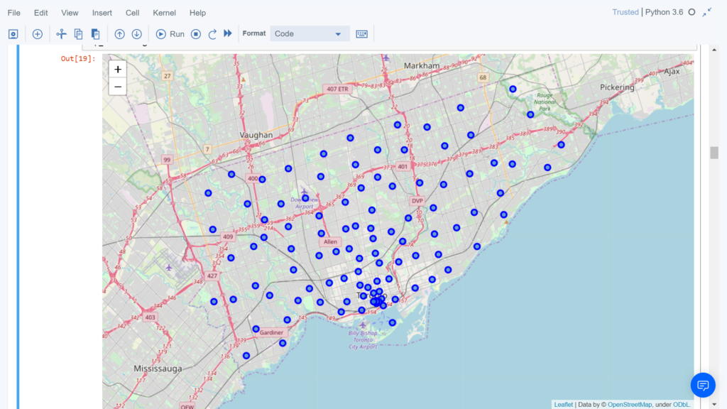
Map of Scarborough

Slide 4
Using K-Means Clustering Approach | Most Common Venue
To compare the similarities of two cities, we decided to explore neighborhoods, segment them, and group them into clusters to find similar neighborhoods in a big city like New York and Toronto.

Slide 5
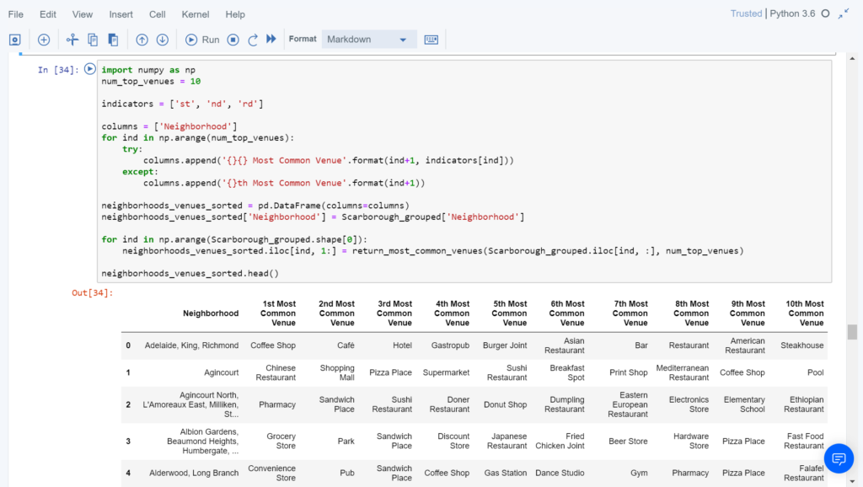
Most Common Venues near Neighborhood | Using Clustering

Slide 6
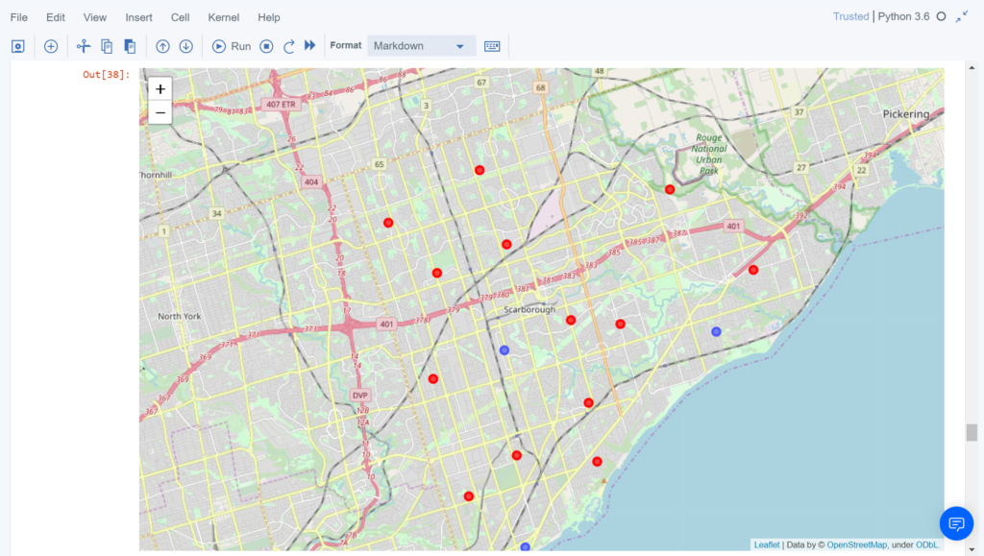
Results Section Map of Clusters in Scarborough

Slide 7
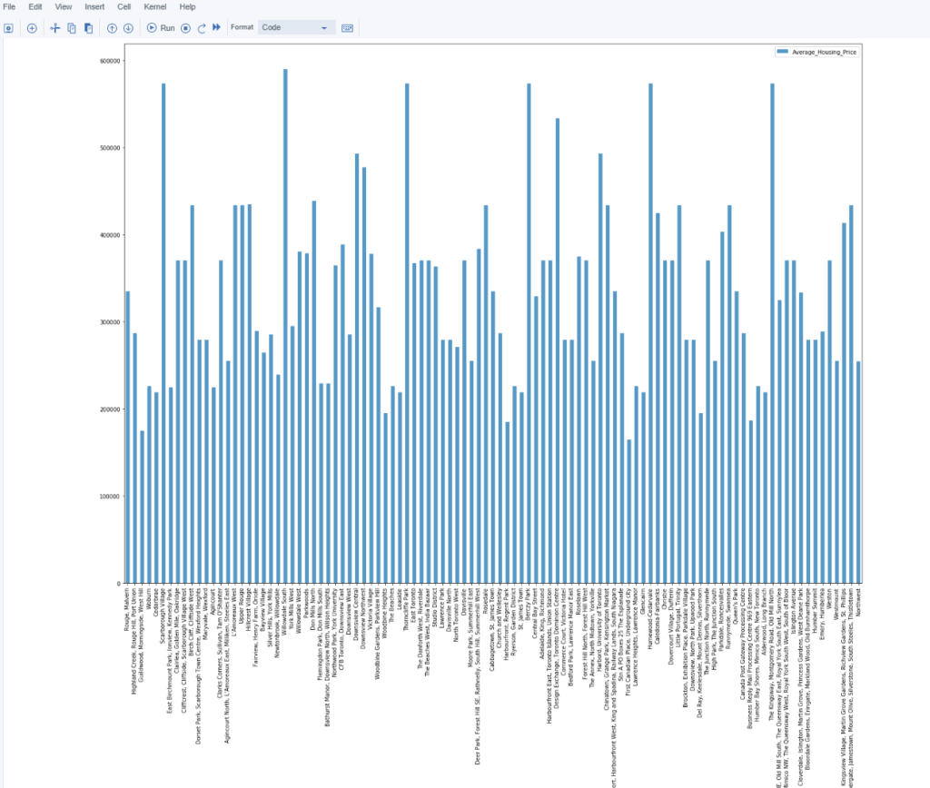
Average Housing Price by Clusters in Scarborough

Slide 8
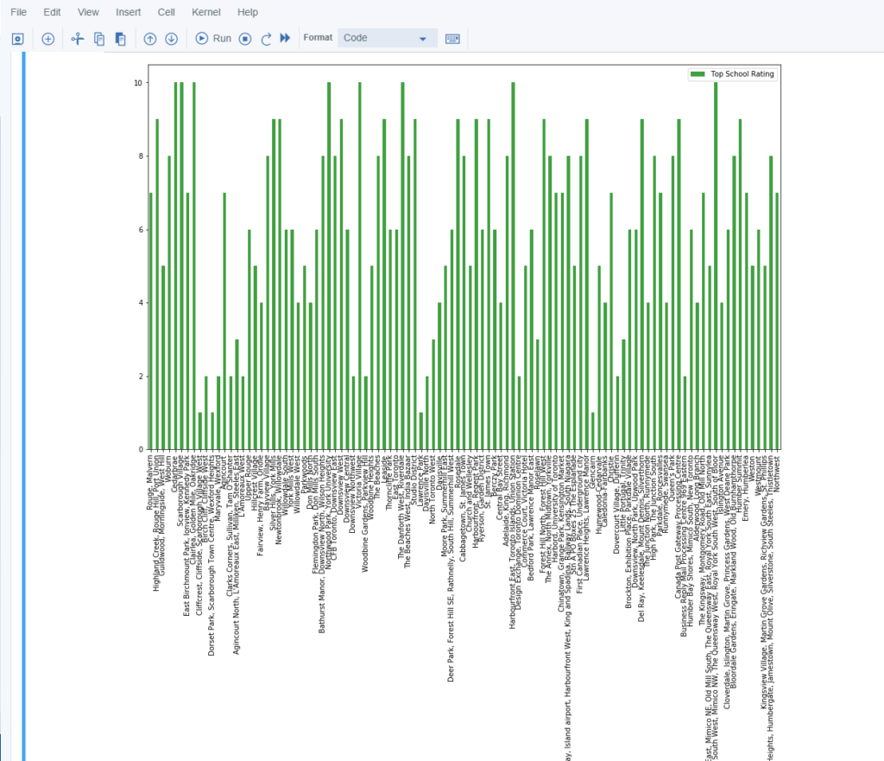
School Ratings by Clusters in Scarborough

Slide 9
Conclusion Section
In this Capstone project, using k-means cluster algorithm I separated the neighborhood into 10(Ten) different clusters and for 103 different lattitude and logitude from dataset, which have very-similar neighborhoods around them. Using the charts above results presented to a particular neighborhood based on average house prices and school rating have been made.

Slide 10
Libraries Which are Used to Develope the Project:
Pandas: For creating and manipulating dataframes.
Folium: Python visualization library would be used to
visualize the neighborhoods cluster distribution of using interactive leaflet map.
Scikit Learn: For importing k-means clustering.
JSON: Library to handle JSON files.
XML: To separate data from presentation and XML stores data in plain text format.
Geocoder: To retrieve Location Data.
Beautiful Soup and Requests: To scrap and library to handle http requests.
Matplotlib: Python Plotting Module.

